Slide 1
Memory Management
Page Replacement Algorithms

Slide 2
Review
Memory Manager
  coordinate how the different types of memory are used
  keep track memory to allocate and release areas of main memory to processes
  manage swapping between main memory and disk
No Memory Abstractions
  Single program
    One OS, only one process
    Special register is used to protection between OS and process
    Disadvantages: slow
  Multiple program
    One OS, many processes locate in memory
    Divided into fixed size block
    Disadvantages
      Internal fragmentations
      Two programs both reference absolute physical memory
      → static relocation

Slide 3
Review
Memory Abstractions
  Multiple processes locate in memory (both primary and secondary)
  Base and Limit Registers
    Multiple processes locate in memory and protection
    Base contains the first address of process in memory, Limit contains the length of process, the process owns private address space
    Disadvantages
      External fragmentation (Defragment)
      Slow
  Swapping
    Multiple processes with ready processes locate in memory and passive processes locate in HDD – swap file area
    Swap out/ in operator
    Disadvantages
      External fragmentation
      Process can not grow in memory and the swap area on the disk is full → data segment upward, stack segment downward

Slide 4
Review
Memory Abstractions
  Memory Management with Bitmaps
    The memory divides units with same size that has a bit corresponding bit in the bitmap (0: free, 1: occupied)
    Disadvantages
      Slow when searching the bitmap to find a run of k consecutive 0 bits in the map (small)
      Internal fragment (large size)
  Memory Management with Linked Lists
    Maintain a linked list of allocated (P) and free memory (H)
    Allocating algorithms
      First, Next, Best, Worst, Quick Fit
  Virtual Memory
    Software/ Process sizes larger than memory
    Overlays
      Developer splits program to many overlays
      Disadvantages: developer‘s knowledge is important

Slide 5
Review
Memory Abstractions
  Virtual Memory
    Paging
      Address space is broken up into pages
      Physical memory is divided up into page frames
      Virtual address vs. Physical address, manage address space with bit
      MMU transfers Virtual address → p, d; then it looks up page table following the index to get the page frame; the page frame combines with d to determine the physical address
      Page fault: the program references a part of its address space that is not in physical memory
      Page table
        Load to collection registers, load to memory using base register, using TLB
        Excessive large page table: multilevel page, inverted page table, inverted page table with hash or TLB
        Entry: Caching disabled, Referenced, Modified, Protection, Present/absent, page frame number

Slide 6
Page replacement algorithms
Problems
At page fault and full physical memory
  Space has to be made
  A currently loaded virtual page has to be evicted from memory
Choosing the page to be evicted
  Not a heavily used page → reduce the number of page faults
Page replacement
  The old page has to be written on the disk if it was modified.
  The new virtual page overwrite ghi đè the old virtual page into the page frame

Slide 7
Page replacement algorithms
Optimal
Each page can be labeled with the number of instructions that will be executed before that page is first reference
Choose the page that will be the latest one accessed in the future between all the pages actually in memory
Very simple and efficient (optimal)
Impossible to be implemented in practice
  there is no way to know when each page will be referenced next
It can be simulated
  At first run collect information about pages references
  At second run use results of the first run (but with the same input)
It is used to evaluate the performance of other, practically used, algorithms đánh giá hiệu suất

Slide 8

Page replacement algorithms
Optimal
Ex:
  a memory with free three frames
  7 0 1 2 0 3 0 4 2 3 0 3 2 1 2 0 1 0 7 0 1
  Number of page faults are 9 times
  Number of page hits are 12 times
→ minimum of page fault is at least size of page frame that is allocated to process
→ principles: more and more page frame is allocated, less and less page fault occurs

Slide 9
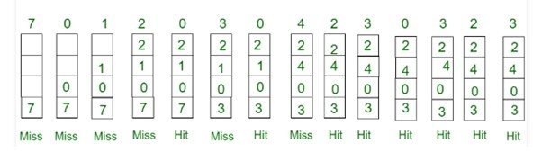
Page replacement algorithms
Optimal
Miss: chưa có bao giờ
Hint: đã va chạm

Slide 10
Page replacement algorithms
Not Recently Used (NRU)
Each page has two status bits associated
  Referenced bit (R)
  Modified bit (M)
The two bits
  updated by the hardware at each memory reference
  once set to 1 remain so until they are reset by OS
  can be also simulated in software when the mechanism is not supported by hardware
Algorithms
  At process start the bits are set to 0
  Periodically (on each clock interrupt) the R bit is cleared
  For page replacement, pages are classified
    Class 0: not referenced, not modified
    Class 1: not referenced, modified
    Class 2: referenced, not modified
    Class 3: referenced, modified
The algorithm removes a page at random from the lowest numbered nonempty class
It is easy to understand, moderately efficient to implement, and gives an adequate performance

Slide 11
Page replacement algorithms
Not Recently Used (NRU) – Example
A computer has four page frames. The time of loading, time of last access, and the R and M bits for each page are as shown below (the times are in clock ticks). Which page will be replaced?
The page 0 is replaced
Page | Loaded | Last Reference | R | M
0 | 226 | 280 | 0 | 0
1 | 160 | 265 | 0 | 1
2 | 110 | 270 | 1 | 0
3 | 120 | 285 | 1 | 1

Slide 12

Page replacement algorithms
First-In, First-Out (FIFO)
OS maintains a list of all pages currently in memory, with
  the most recent arrival at the tail
  the least recent arrival at the head
On a page fault, the page at the head is removed and the new page added to the tail of the list
It’s rarely used
Ex:
  a memory with free three frames
  7 0 1 2 0 3 0 4 2 3 0 3 2 1 2 0 1 0 7 0 1

Slide 13
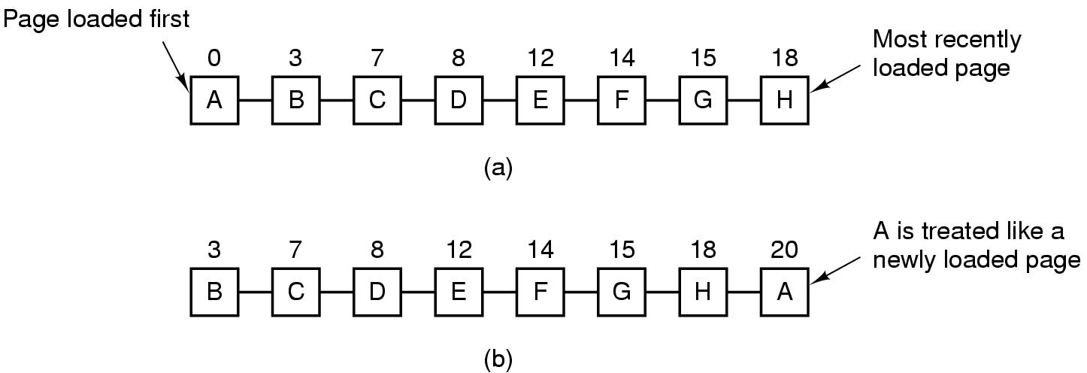
Page replacement algorithms
Second-Chance
A modification of FIFO to avoid throwing out a heavily used page
Inspect the R bit of the oldest page
    0 → page is old and unused cũ chưa dùng → replaced
    1 → page is old but used → its R bit = 0 and the page is moved at the end of the queue as a new arrived page.
Look for an old page that has not been not referenced in the previous clock interval
If all the pages have been references → FIFO
Tanenbaum, Fig. 3-15.

Slide 14
Page replacement algorithms
Second-Chance – Example
A computer has four page frames. The time of loading, time of last access, and the R and M bits for each page are as shown below (the times are in clock ticks). Which page will be replaced?
The page 1 is replaced
Page | Loaded | Last Reference | R | M
0 | 226 | 280 | 0 | 0
1 | 160 | 265 | 0 | 1
2 | 110 | 270 | 1 | 0
3 | 120 | 285 | 1 | 1

Slide 15
Page replacement algorithms
Clock
In a second chance algorithms, it is unnecessarily inefficiency ko cần thiết hiệu quả because it is constantly moving pages around on its list
Keep all the page frames on a circular list in the form of a clock
The hand points con trỏ to the oldest page
How to work
  When a page fault occurs, the page being pointed to by the hand is inspected
  If its R bit is 0, the page is evicted, the new page is inserted into the clock in its place, and the hand is advanced one position
  If R is 1, it is cleared and the hand is advanced to the next page

Slide 16
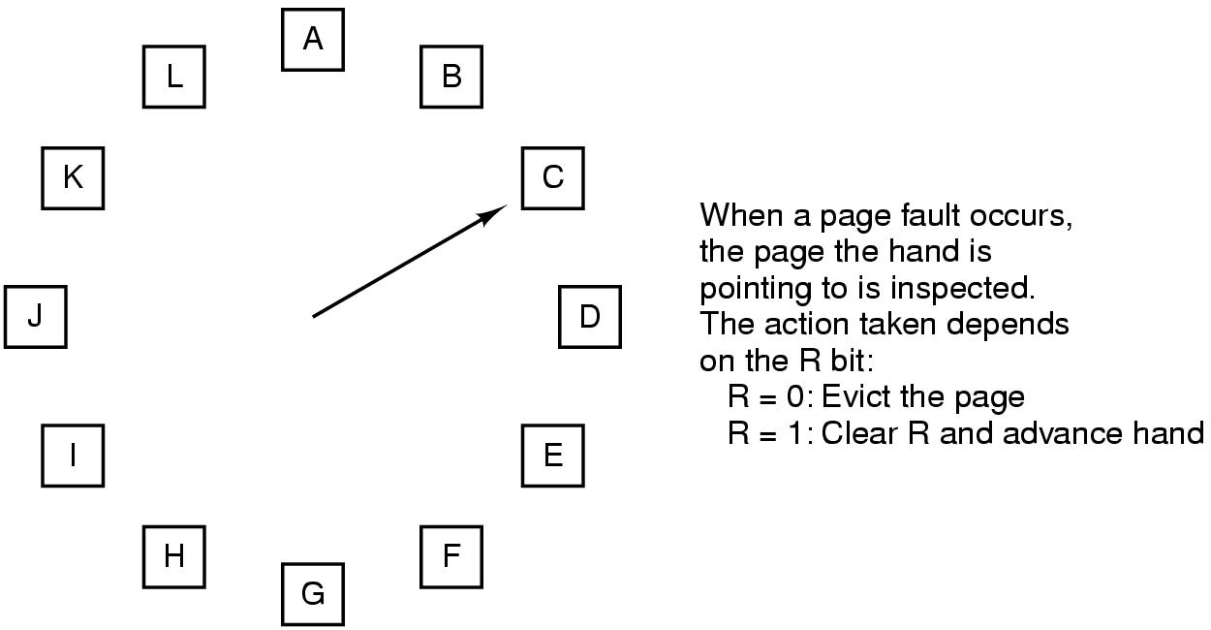
Page replacement algorithms
Clock
Tanenbaum, Fig. 3-16.

Slide 17
Page replacement algorithms
Least Recently Used (LRU)
Based on the observation that
  pages that have been heavily used in the last few instructions will probably be heavily used again in the next few
Throw out the page that has been unused for the longest time when a page fault occurs
The algorithm keeps a linked list
  the referenced page is moved at the front of the list
  the page at the end of the list is replaced
  the list must be updated at each memory reference → costly
Implementing LRU with a hardware counter
  keep a 64-bit counter which is incremented after each instruction
  each page table entry has a field large enough to store the counter
  the counter is stored in the page table entry for the page just referenced
  the page with the lowest value of its counter field is replaced
Implementing LRU with a hardware bits matrix
  N page frames → N x N bits matrix
  when virtual page k is referenced tham chiếu
    bits of row k are set to 1
    bits of column k are set to 0
  the page with the lowest value is removed

Slide 18

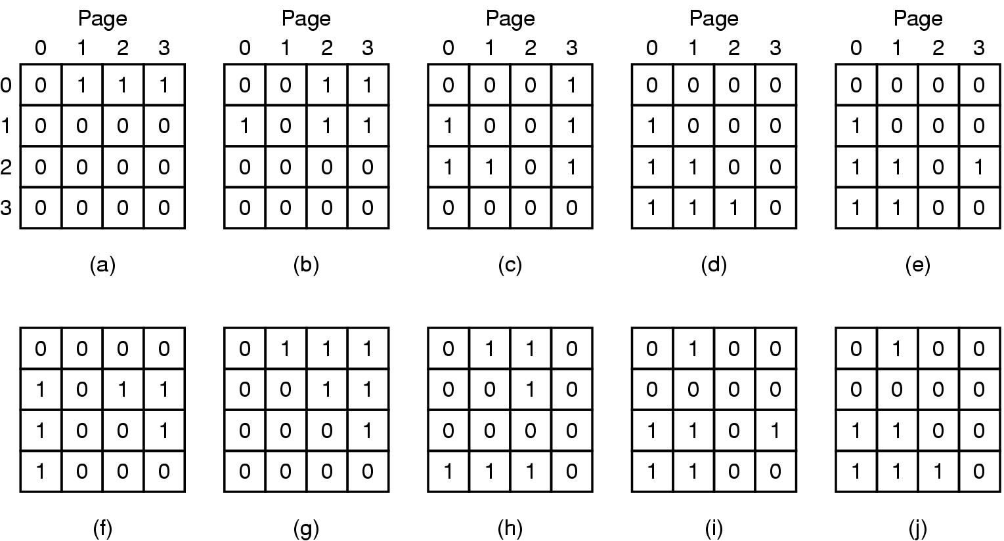
Page replacement algorithms
Least Recently Used (LRU)
Ex:
  a memory with free three frames
  7 0 1 2 0 3 0 4 2 3 0 3 2 1 2 0 1 0 7 0 1
  A memory with four page frames
  0 1 2 3 2 1 0 3 2 3
Tanenbaum, Fig. 3-17.
Page 3 bị thay thế

Slide 19
Page replacement algorithms
Least Recently Used (LRU) – Example
A computer has four page frames. The time of loading, time of last access, and the R and M bits for each page are as shown below (the times are in clock ticks). Which page will be replaced?
The page 1 is replaced
Page | Loaded | Last Reference | R | M
0 | 226 | 280 | 0 | 0
1 | 160 | 265 | 0 | 1
2 | 110 | 270 | 1 | 0
3 | 120 | 285 | 1 | 1

Slide 20
Page replacement algorithms
Not Frequently Used (NFU)
A software implementation of LRU
A software counter associated with each page (initially 0)
At each clock tick the R bit is added to the counter for all the pages in memory; after that the R bits are reset to 0
The page with the lowest counter is chosen when a page fault occurs
Problem:
  The useful pages are evicted
  The bit reference is useful to count the page to be reference, but it is not known the order of reference

Slide 21
Page replacement algorithms
Aging
A software implementation of LRU
modification of NFU
  Shift right the counter one position
  R bit is added to the leftmost bit
  The page whose counter is the lowest is removed when a page fault occurs
  Differences from LRU
    does not know the page which was referenced first between two ticks; for example pages 3 and 5 at step (e)
    the finite number of bits of counters → does not differentiate between pages with the value 0 of their counter

Slide 22
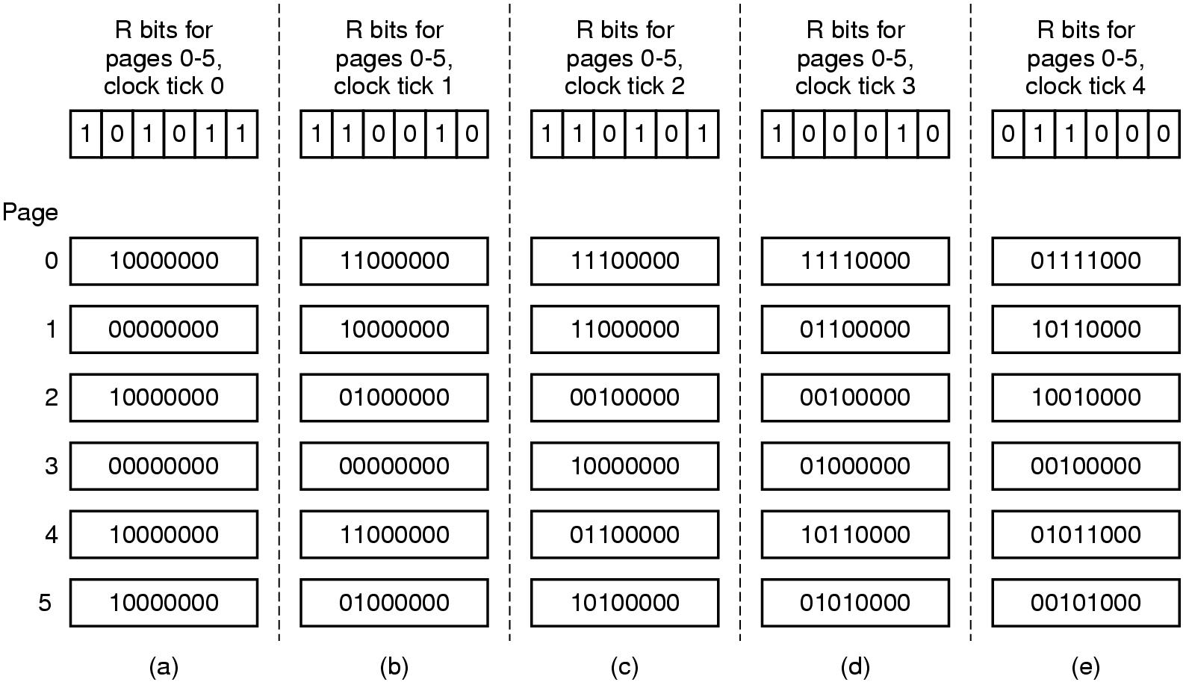
Page replacement algorithms
Aging
Tanenbaum, Fig. 3-18.

Slide 23
Page replacement algorithms
Thrashing
A program causing page faults every few instructions
A process is not allocated enough page frames as its requirements
  → Many processes are located in memory, thus, each process is allocated at least page frames
  → The page replacement takes more time (than execution)
→ The CPU utilization is decreased and some new process is loaded in the memory
The impact of thrashing on system
  The system can be hanged
  The process can not continually progress
Solution
  Allocating enough page frame (!?) to the process
  How to know the process need the number of page frame in progress

Slide 24
Page replacement algorithms
Locality of Reference
The process references only a relatively small fraction of its pages in execution
  A small fraction is a set of pages that a process is currently using
  The process moves from small fractions (that is needed in execution in time) to others
The process involves many small fractions that can intersected

Slide 25
Page replacement algorithms
Demand paging vs. Prepaging
Demand paging: Pages are loaded only on demand
  Processes are started up with none of their pages in memory
  CPU tries to fetch the first instruction → page fault
Prepaging
  Loading the pages before letting processes run
  Loading the pages before resuming the process

Slide 26
Page replacement algorithms
Working Set
The set of pages that a process is currently using
If the entire working set is in memory, the process will run without causing many faults until it moves into another execution phase
Working set can changes over time
Problems
  If the available memory is too small to hold the entire working set, the process will cause many page faults and run slowly → thrashing
  The process will just cause page faults until its working set has been loaded → slow, waste considerable CPU time
Solutions
  Using working set model

Slide 27
Page replacement algorithms
Working Set Model
Keep track of each process’s working set and make sure that it is in memory before letting the process run (prepaging)
Reduce the page fault rate (avoid thrashing)
Is implemented as
  OS keeps track of which pages are in the working set
  When a page fault occurs, find a page not in the working set and this page is located in
  R bit is examined.
  If R’s value is 1, the current virtual time is written into the Time of last use field
  If R’s value is 0, the page may be a candidate to removal
    The age (the current virtual time – its Time of last use) is computed and compared with τ (span multiple clock ticks).
    If age > τ, the page is no longer in the working set, and the new page replaces it
    Otherwise, the page is still in the working set
    If the entire table is scanned without finding the candidate to evict and one or more pages with R = 0 is founds, the one with the greatest age is evicted. Otherwise, the chosen random is executed (R = 1)

Slide 28
Page replacement algorithms
WSClock
Problem
  Working set algorithm is cumbersome, since the entire page table has to be scanned at each page fault until a suitable candidate is located
WSClock
  Improved WS algorithm is based on the clock algorithm
  Simplicity of implementation and good performance
  A circular list of page frames is used
  How it works
    This list is empty (initially)
    The page is loaded, it is added to the list to form a ring (with Time of last use field and R bit)
    As with the clock program, at each page fault the page pointed to by hand is examined first
    If R is set to 1, the page has been used during the current tick, then R set to 0, the hand advanced to next page
    If R equals 0,
      if the age is greater than τ and the page is clean, it is not in working set and a valid copy exists on disk. The page frame is simply claimed and the new page put there
      If the page dirty, it cannot claim immediately (clean page is define base on write to disk scheduled)

Slide 29
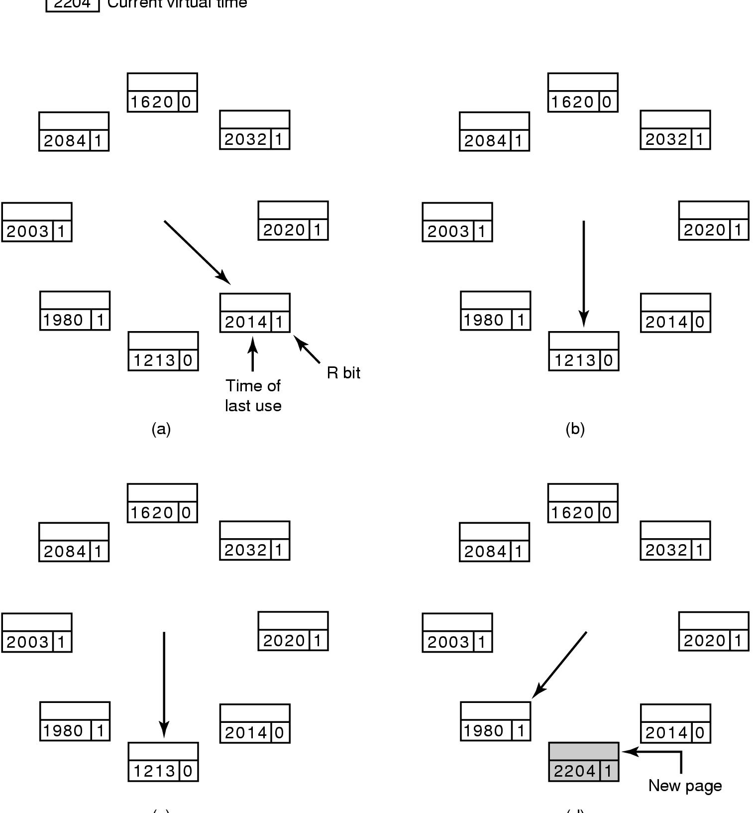
Page replacement algorithms
WSClock
Tanenbaum, Fig. 3-21.

Slide 30
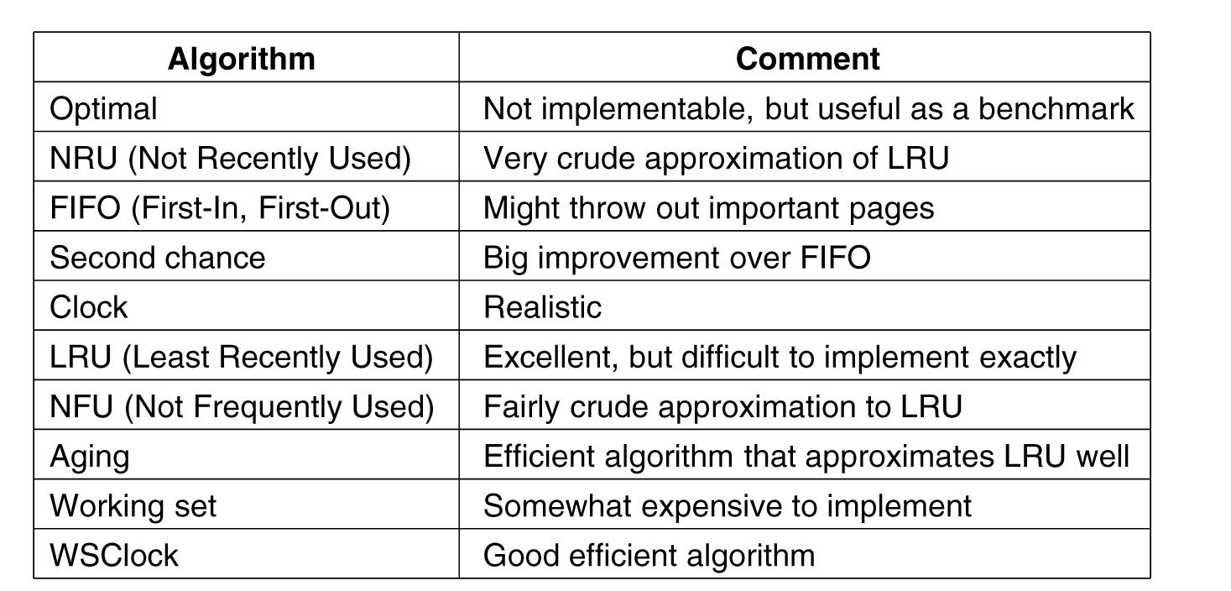
Page replacement algorithms
Summary
Tanenbaum, Fig. 3-22.

Slide 31
Summary
Page replacement Algorithms
Q&A

Slide 32
Next Lecture
Design the Paging Systems

